Slide 1
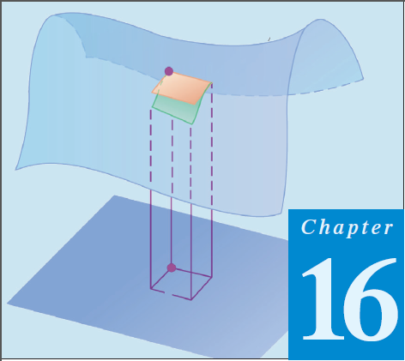
12
Thomas Calculus 12th (Chapter 16)
Calculus 9rd, Dale Varberg, Edwin Purcell and Steve Rigdon (C.14)
INTEGRATION IN VECTOR FIELDS
Samuel Lukas

Slide 2
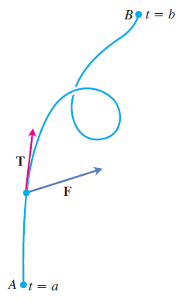







Work Done by a Force over a Curve

Slide 3
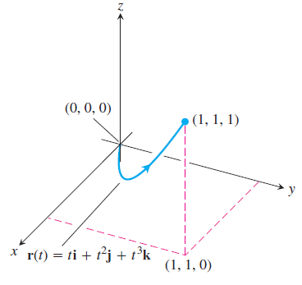





Slide 4









Evaluate :

Slide 5
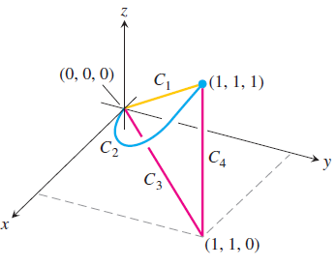
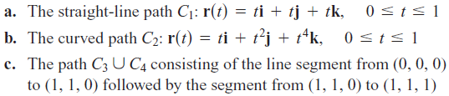
Exercises 1
In Exercises 1 – 6, find the work done by force F from (0, 0, 0) to (1, 1, 1) over each of the following paths :
1.
2.
3.
4.
5.
6.
What is your conclusion ?

Slide 6

In Exercises 7 – 10, find the work done by F over the curve in the direction of increasing t.
07.
08.
09.
10.

Slide 7

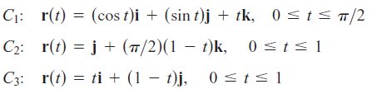
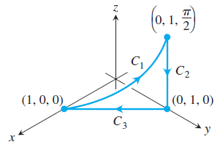
10.

